Slide 1
project PROPOSAL
Team member:
WEI LIU, XIANGTIAN ZHENG

Slide 2
Content
1. Project Description
2. Project Core Idea
3. UX design
4. Project Timeline and Planning
5. Risk
6. Trello

Slide 3
Project Description
Features:
Simple, reliable task publish platform
Various, useful user interface design
Interactive design for user
Target audience:
Gender : Any
Age: 15 to 80
Location: Australian

Slide 4
Project core idea
Our idea is mission platform which is a diversification platform. Any of nature tasks can be posted on the platform and seeking opportunity to corporate with people that who has the item or skill to complete the task or any some kind of services or technical assistance, through the platform users will achieve the a win-win situation.

Slide 5
Project Timeline and Planning
Timeline:
Week 6: App UX/UI design planning
Week 7-8: App Layout design, including Task list, user interface; Bottom image design
Week 9-11: Database set up for users and registration

Slide 6
Risk
Technical issues:
Database set up issue
String value on different as a list view
Image design quality
Cross platform running

Slide 7
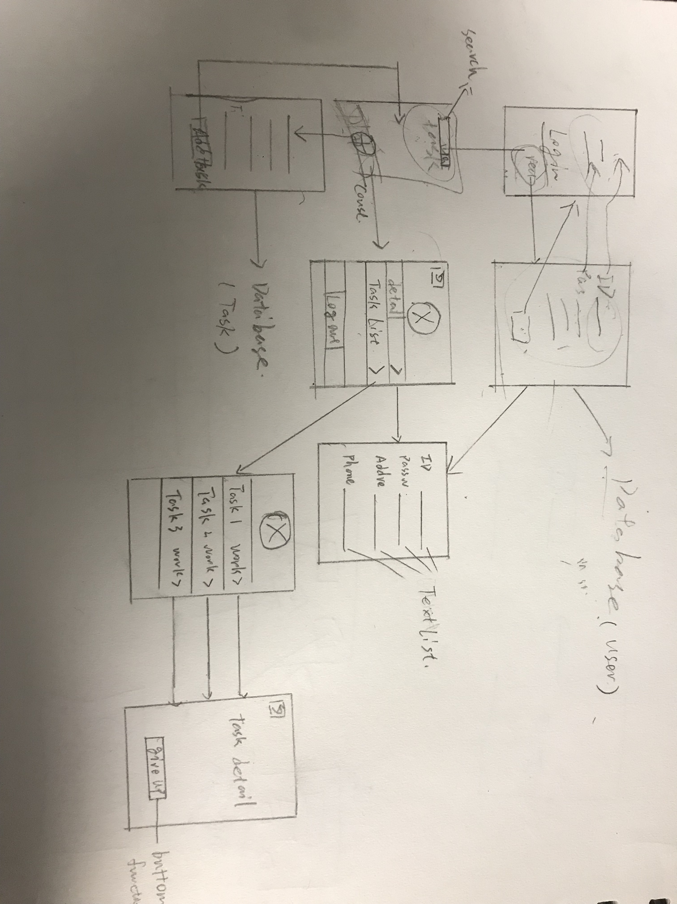
UX Design

Slide 8
Trello

